Slide 1
Computer Graphics Rendering
Lecture 13: Path tracing
Kartic Subr

Slide 2

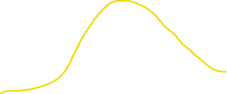
Recap: MC integration estimator
Sampler
function
pdf

Slide 3
Recap: MC integration estimator
Sampler

Slide 4

Recap: impact of sampling pdf
Sampler
Sampler
Sampler

Slide 5



Dividing by the sampling pdf
Sampler
Sampler
Sampler

Slide 6
MC integration errors

Slide 7
MC integration errors

Slide 8
MC integration: importance sampling

Slide 9
Light transport

Slide 10


Incident or incoming radiance at x
$$n$$
$$x$$

Slide 11




Differential irradiance at infinitesimal patch
$\text{d}E_{i}$ = $L(x, ω_{i})\text{ (}ω_{i}\text{.}\text{n}\text{) }\text{d}ω_{i}$
$$n$$
radiance
$$L(x, ω_{i})$$
W m⁻²
differential irradiance at x,
due to one incident ray
W m⁻² Sr⁻¹
$$\text{d}ω_{i}$$
$$\text{dA}$$
$$x$$

Slide 12

Outgoing radiance along a direction
radiance
$$L(x, ω_{i})$$
$$L(x, ω_{o})$$
$$\text{d}ω_{i}$$
$$\text{dA}$$
$$x$$

Slide 13

Linear optics: reflected radiance ∝ irradiance
d$L\left(x, ω_{o}\right)$ p$roportional to \text{d}E_{i}$

Slide 14

Linear optics: reflected radiance ∝ irradiance
d$L\left(x, ω_{o}\right)$ = $ρ(ω_{i},ω_{o})$ $\text{d}E_{i}$

Slide 15
Constant of proportionality is a function!
d$L\left(x, ω_{o}\right)$ = $ρ(ω_{i},ω_{o})$ $\text{d}E_{i}$
Constant for a given pair of incident-outgoing directions
Determines appearance of opaque materials
Bidirectional Reflectance Distribution Function (BRDF)-

Slide 16


BRDF slice per incident direction
$$ω_{i}$$
$ρ(ω_{i},:)$
more light along
direction of specular reflection

Slide 17
BRDF slice per incident direction
$$ω_{i}$$
$ρ(ω_{i},:)$
more light along
direction of specular reflection

Slide 18
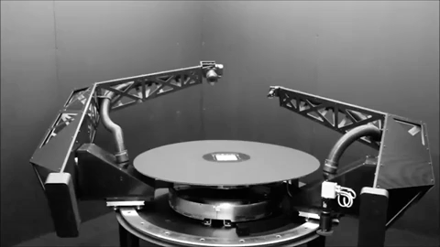
BRDF measurement - gonioreflectometer
tabulate 4D measured values?
[robotae]
http://www.cs.cmu.edu/afs/cs/academic/class/15462-f09/www/lec/lec9.pdf

Slide 19
phase functions
commonly used material models
BSDF
BSSRDF
SvBRDF

Slide 20

Reflection: multiple incident rays
$L\left(x, ω_{o}\right)$ = $\sum_{i}{ ρ(ω_{i},ω_{o}) \text{d}E_{i}}$
contributions for different directions weighted by BRDF

Slide 21

Add emission from surface at x
$L\left(x, ω_{o}\right)$ =$L_{e}\left(x, ω_{o}\right)$ + $\sum_{i}{ ρ(ω_{i},ω_{o}) \text{d}E_{i}}$
contributions for different directions weighted by BRDF

Slide 22

In the limit …
$L(x, ω_{o})$ = $L_{e}\left(x, ω_{o}\right)$. + $\int_{H^{2}}^{ }{ ρ\left(ω_{i},ω_{o}\right) L(x, ω_{i}) \text{(}ω_{i}\text{.}\text{n}\text{) }\text{d}ω_{i}}$
surface emission
hemisphere
BRDF
incident radiance
cosine dependence
… the rendering equation
[Kajiya 86]

Slide 23
The rendering equation
[Kajiya 86] https://dl.acm.org/citation.cfm?id=15902

Slide 24
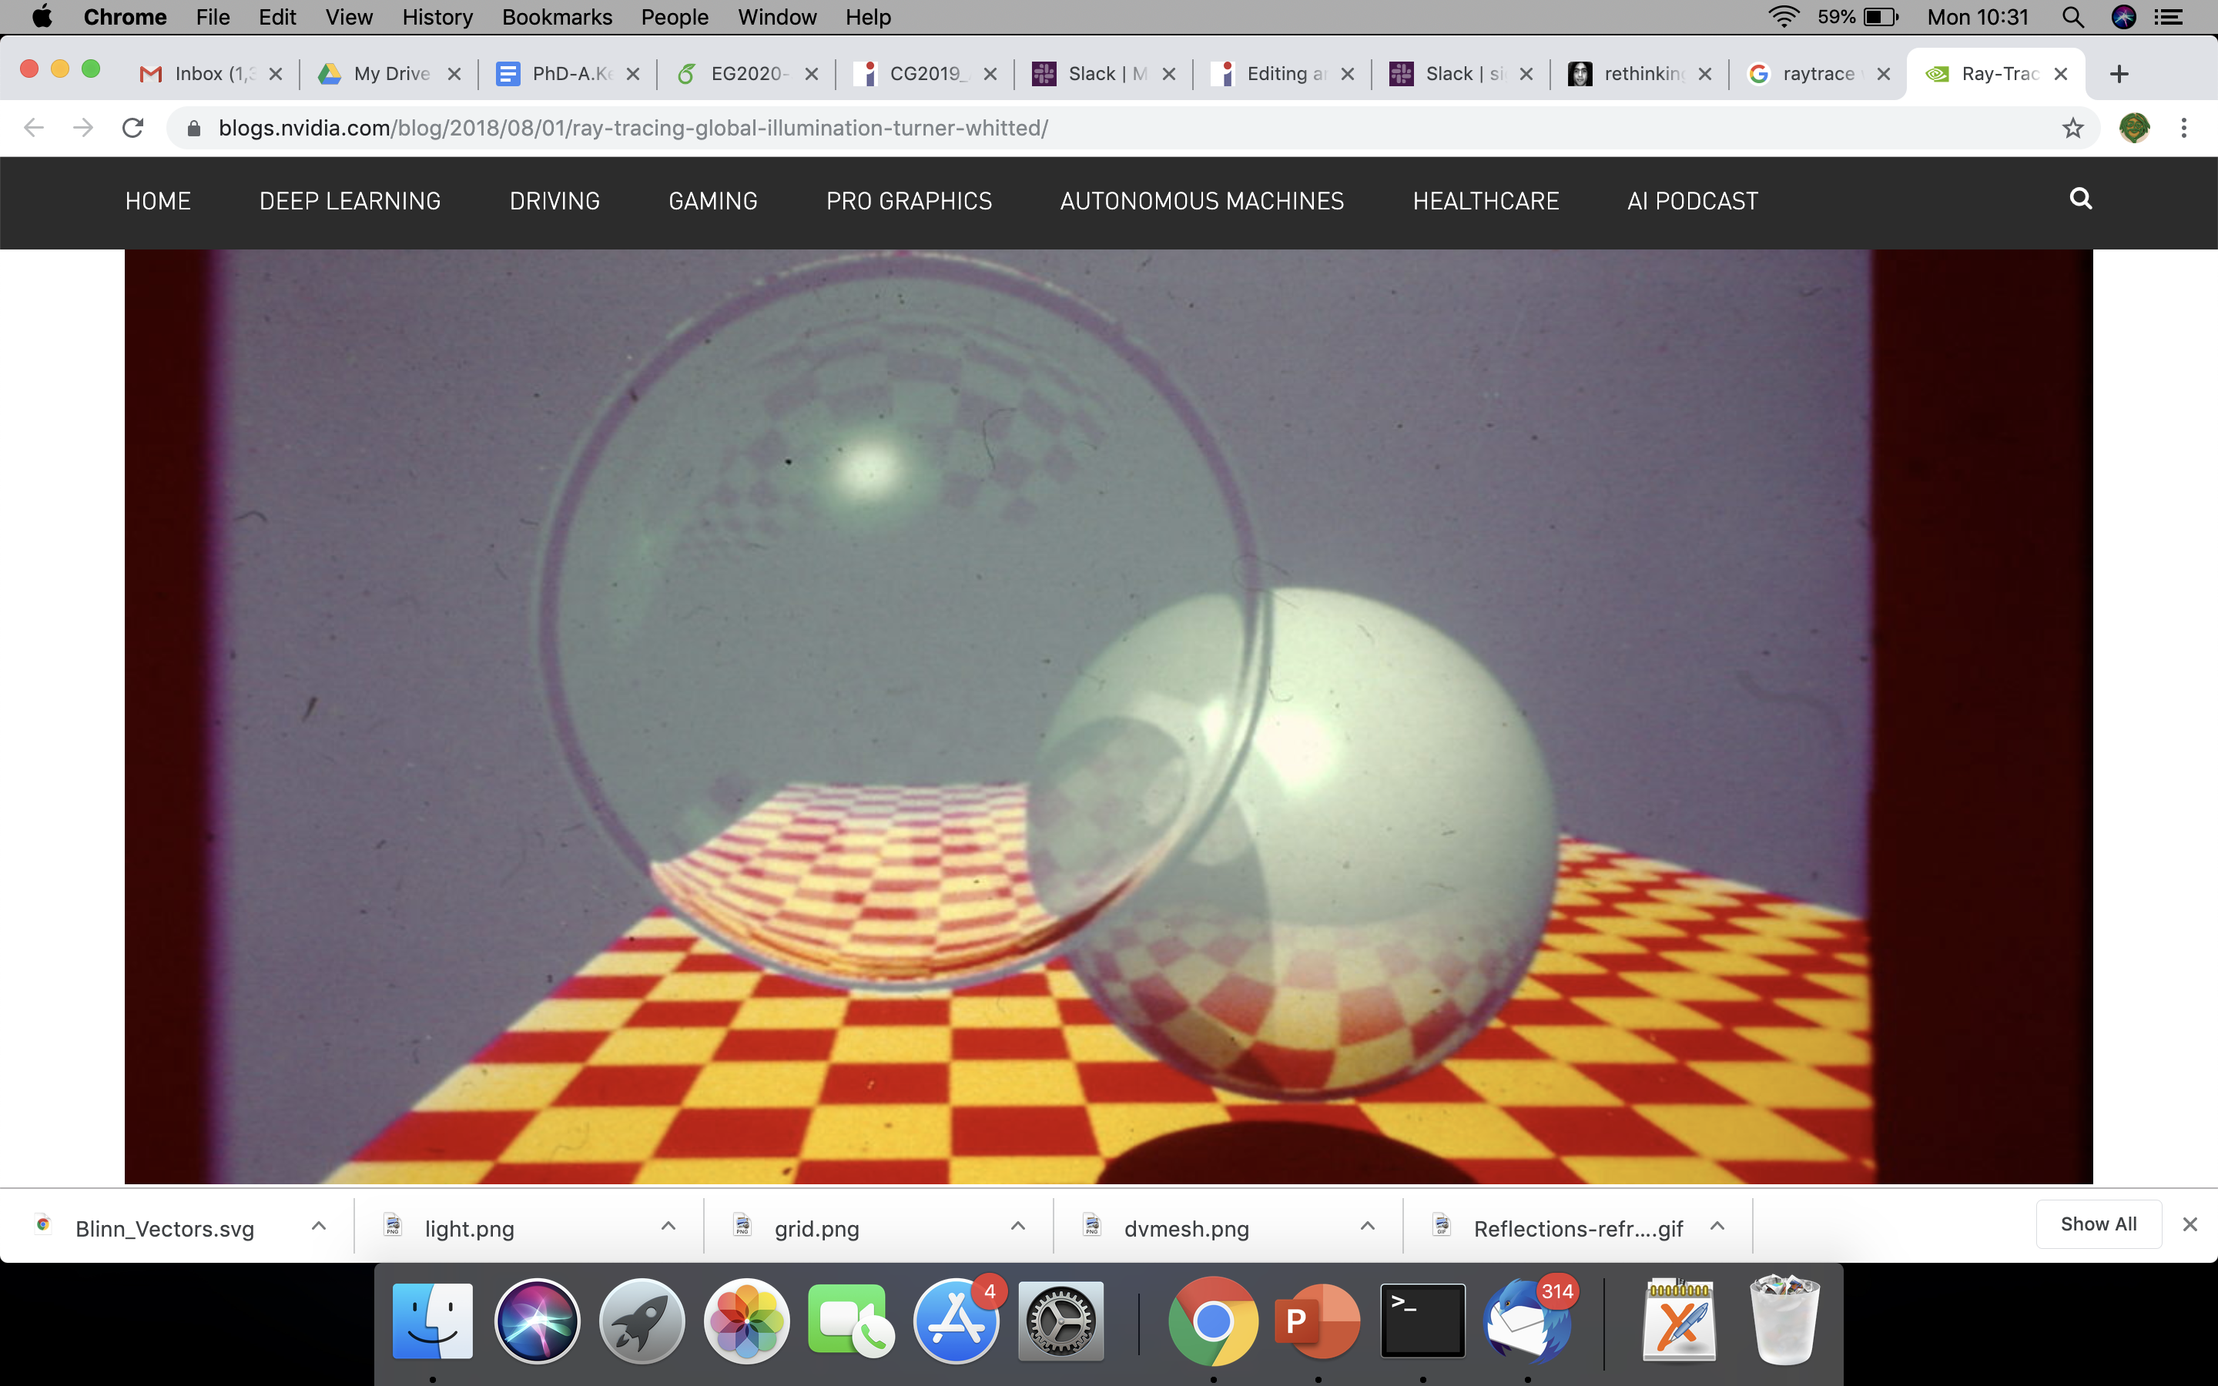
Contrast with Whitted raytracing
How to get ‘soft’ shading and lighting effects?

Slide 25
Solving the rendering equation

Slide 26


Estimate integrals recursively
1) Sample hemisphere at last bounce to camera

Slide 27

Estimate integrals recursively
1) Sample hemisphere at last bounce to camera
2) Trace each sample ray back to intersection

Slide 28
Estimate integrals recursively
1) Sample hemisphere at last bounce to camera
2) Trace each sample ray back to intersection
3) Sample those hemispheres
4) Recurse until k bounces
5) Use recursion results to estimate radiance

Slide 29
Estimate integrals recursively
k bounces with n samples each
= n^k samples per pixel
e.g. 8000 spp if n = 20 and k = 3

Slide 30
Let there be blur!
Numerical integration
aperture
time
materials
penumbra
Distributed ray tracing [Cook et al 1984]

Slide 31
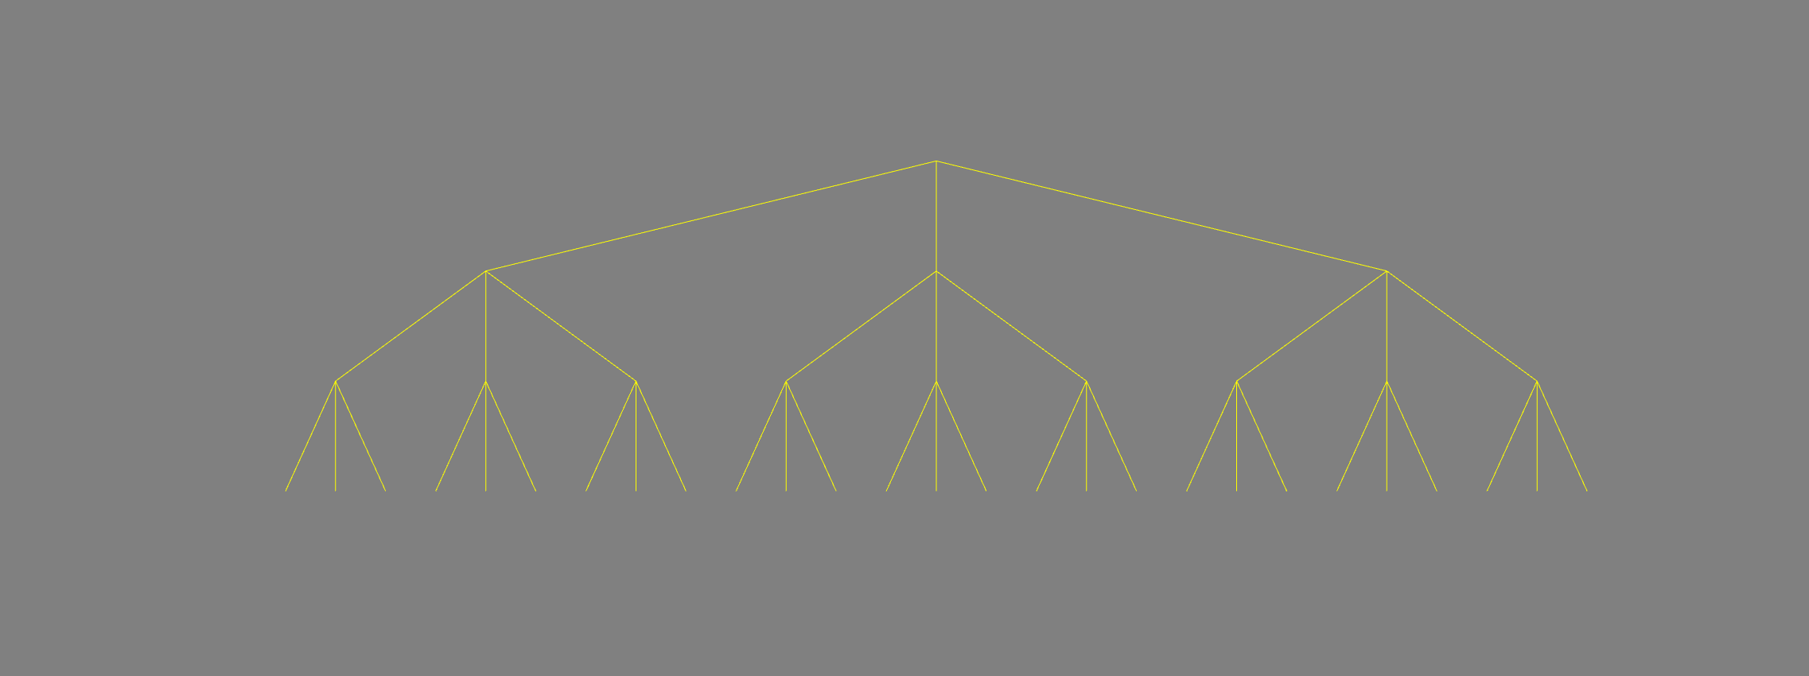
Whitted ray tracing – ray tree
primary ray
1 bounce
reflected ray
refracted ray
light ray
2 bounces
3 bounces : 3^3 = 27 rays

Slide 32
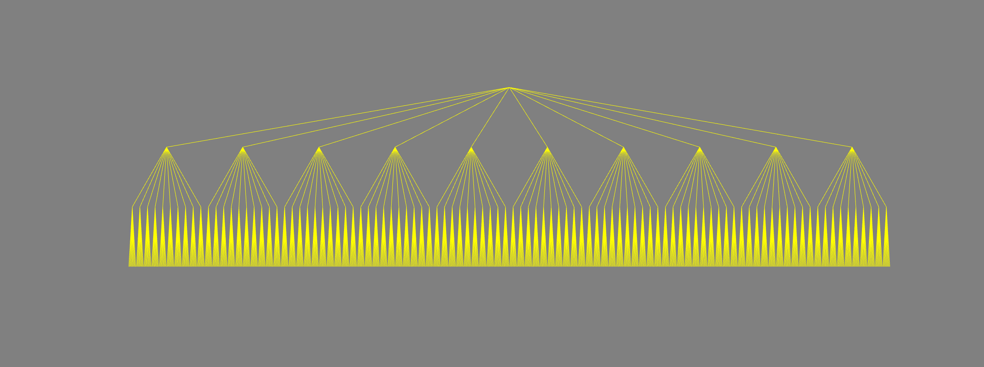
Distributed ray tracing – ray tree
primary ray
estimating integral by averaging
1 bounce
2 bounces
3 bounces : 10^3 = 1000 rays

Slide 33
Helps, but expensive!

Slide 34

Better way to solve the rendering equation?
estimating integral by averaging
path tracing [Veach98]

Slide 35
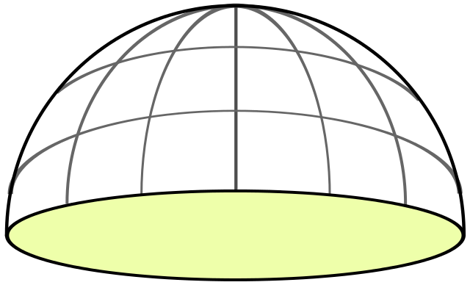
Random sampling at each level
x₁ drawn randomly in [0,1] x [0,1]

Slide 36
Random sampling at each level
x₂ drawn randomly in [0,1] x [0,1]

Slide 37
When to terminate?
x_{d} drawn randomly in [0,1] x [0,1]
?

Slide 38
When to terminate path?
Fixed depth d
When radiance is low
threshold
randomly
Russian roulette

Slide 39


More bounces? depends on scene
2 bounces
9 bounces
https://twitter.com/DisneyAnimation/status/1146085535057715200

Slide 40
Path tracing each pixel - overview
pixel area
2D
aperture
2D
2d+5 dimensions
exp. time
1D
bounces
d*2D
pixel value = average radiance
(over sampled paths)

Slide 41
Path tracing each pixel - overview
pixel area
2D
aperture
2D
2d+5 dimensions
N samples
per pixel
exp. time
1D
bounces
d*2D
pixel value = average radiance
(over sampled paths)

Slide 42
Path tracing: mapping samples to paths
pixel area
2D
aperture
2D
2d+5 dimensions
N samples
per pixel
exp. time
1D
map sample to path
& record radiance
randomly sample
the hypercube
bounces
d*2D
pixel value = average radiance
(over sampled paths)

Slide 43
Path tracing: mapping samples to paths
pixel area
2D
aperture
2D
2d+5 dimensions
N samples
per pixel
exp. time
1D
bounces
d*2D
randomly sample
the hypercube
map sample to path
& record radiance
pixel value = average radiance
(over sampled paths)

Slide 44
Path tracing - maths
pixel average radiance
pixel filter weighting
[https://jo.dreggn.org/path-tracing-in-production/2019/index.html

Slide 45
http://madebyevan.com/webgl-path-tracing/

Slide 46
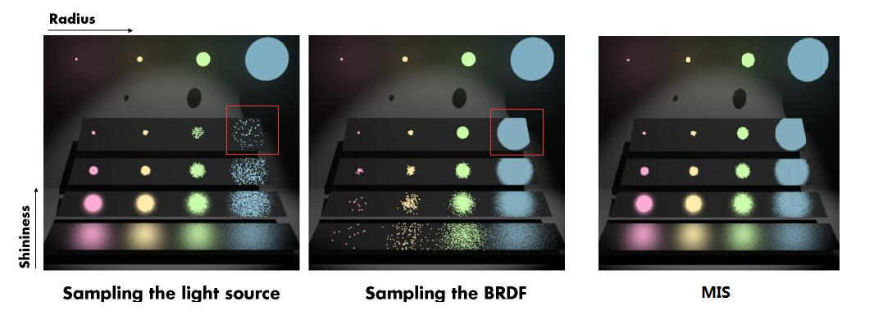
Importance sampling paths

Slide 47
Importance sampling paths

Slide 48
Importance sampling paths

Slide 49
This course so far …
maths
physics
self-learning
programming

Slide 50
This course so far …
self-learning
maths
physics
programming

Slide 51

This course
v 1.0 (2007, Columbia University, NY)
Evolved
current trends/needs (e.g. online resources, LLMs)
mixture of fun + skills (awareness vs career in CG)

Slide 52
Feedback/appraisal
Piazza (anonymous)
email me (personal)
Love the course? Consider nominating me …
(will open in Sem 2)
https://www.eusa.ed.ac.uk/whatson/awards/teachingawards

